Slide 1
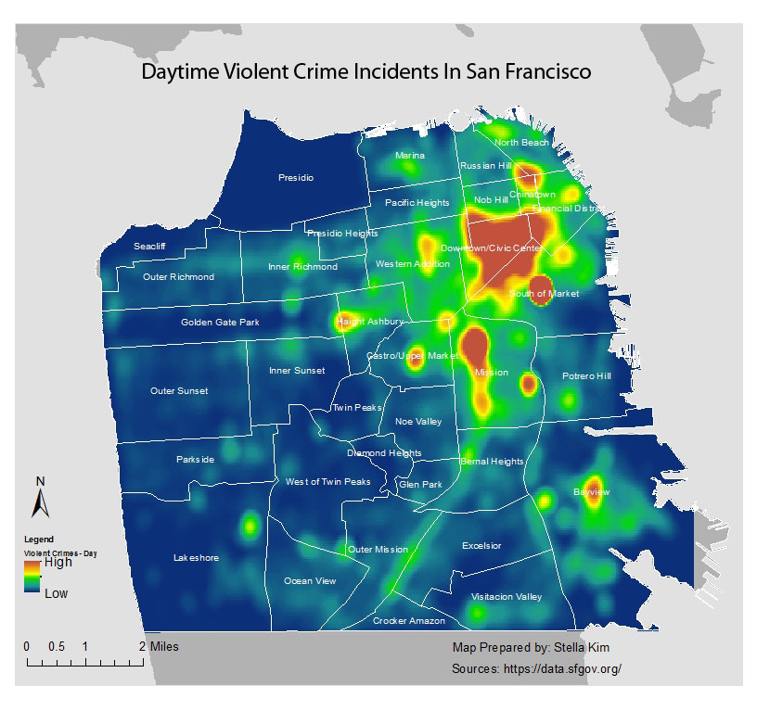
Quadrats and kernel density analysis
Geog4/6300-Shannon

Slide 2
Kernel density estimation

Slide 3
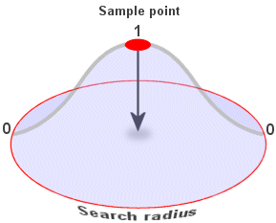
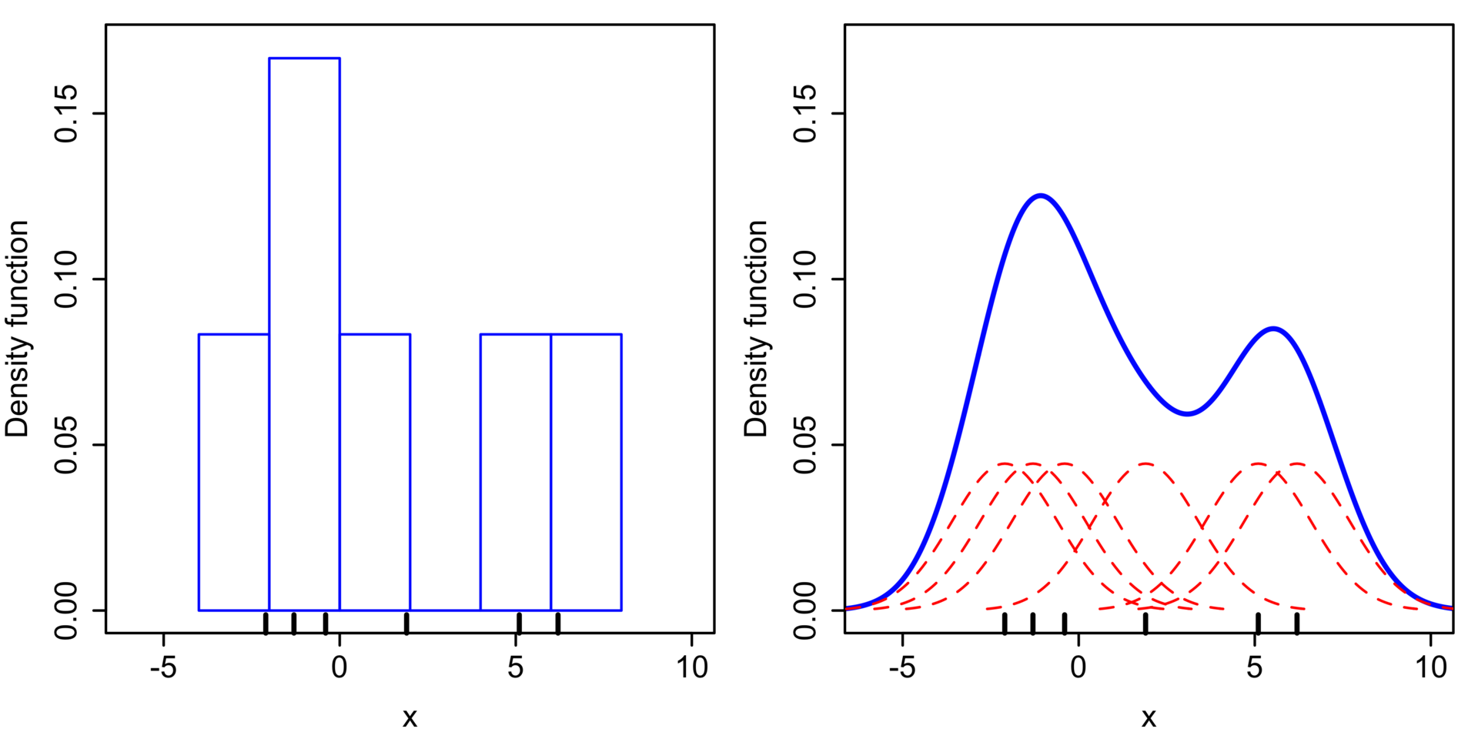
Kernel density estimation

Slide 4

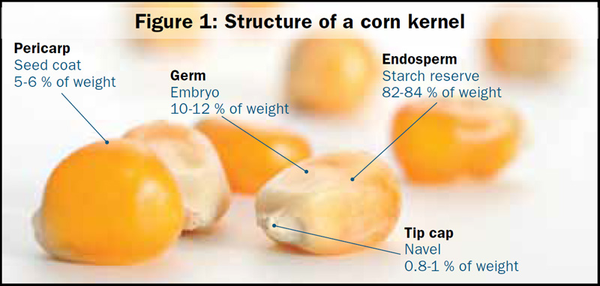
Problems with kernel density estimation
Points sometimes need to be normalized
Fuzzy estimates rather than precise points
Influential outliers

Slide 5
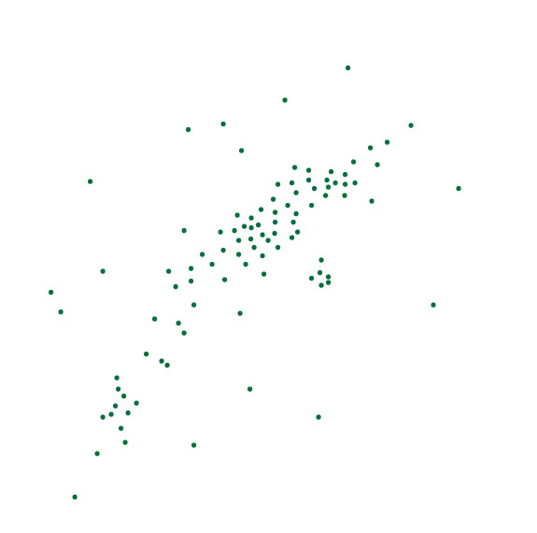
Quadrat analysis
How can we visualize/analyze this pattern?

Slide 6
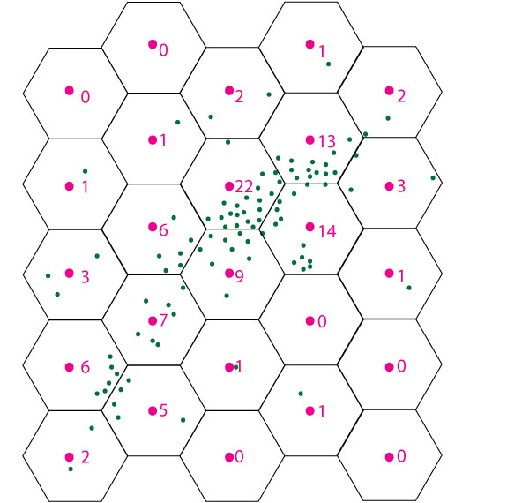
Quadrats are grid cells overlaid upon an area.
Grid size/shape is arbitrary.

Slide 7
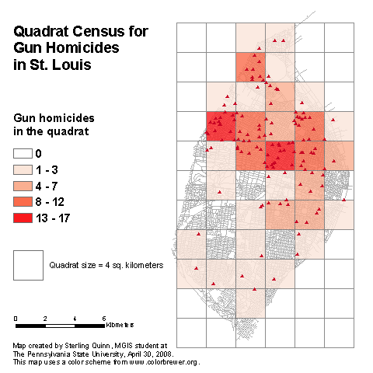
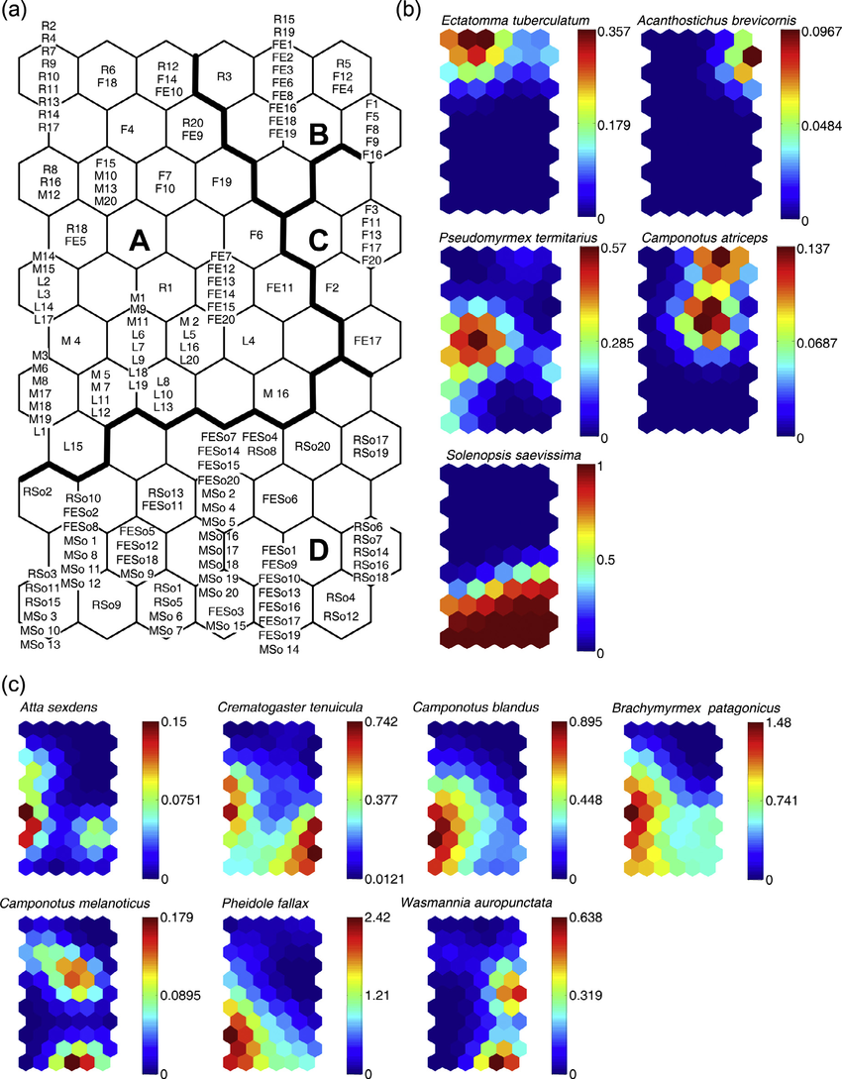
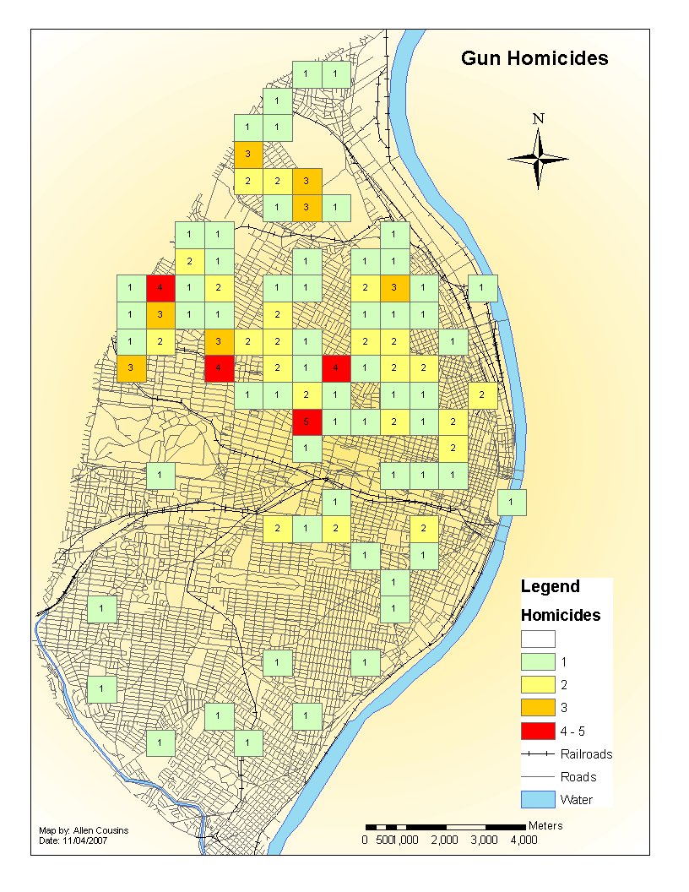

Slide 8
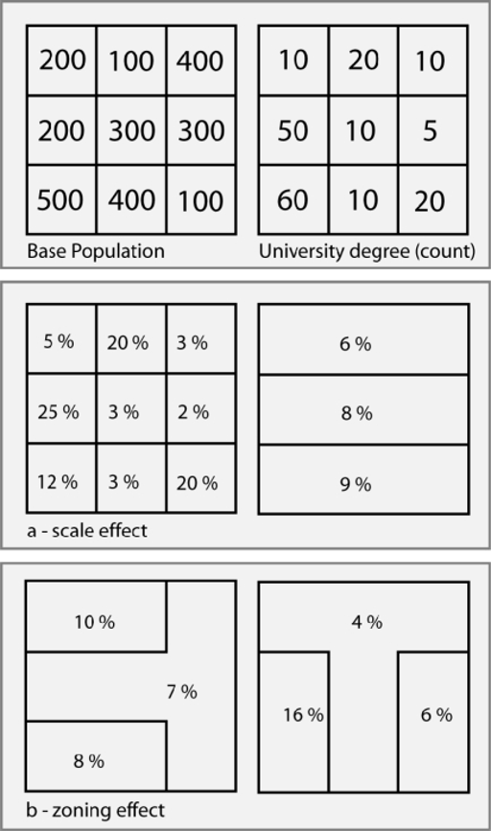
The Modifiable Areal Unit Problem (MAUP)
NIH

Slide 9
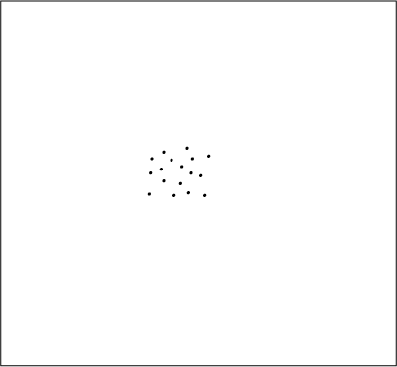
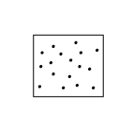
The boundary problem
How do study area boundaries affect data?
Point pattern statistics:
Dispersion
Central tendency

Slide 10
Edge effects
Edges divide or leave out data

Slide 11
Edge effects
2
1
3
1
3
2
3
3
3
2
2
1

Slide 12
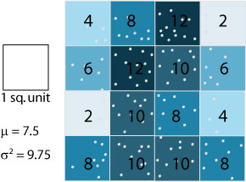
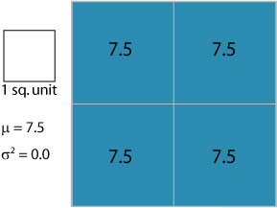
Scale effects
Tension:
Increasing aggregation distorts real phenomenon
Increasing aggregation can reveal patterns
Actually 30 points in these cells, but broken in fourths, mean is 7.5

Slide 13
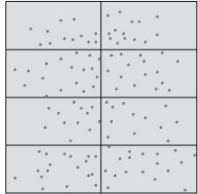
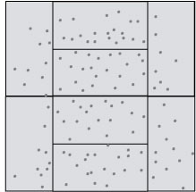
Zoning problem
Interpretation of choropleth maps depends on the areal definitions
Ex.: zip codes, census tracts, school zoning…

Slide 14
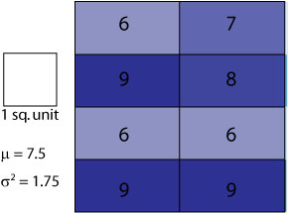
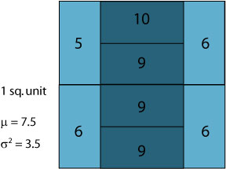
Zoning problem
Same mean, but different variance

Slide 15
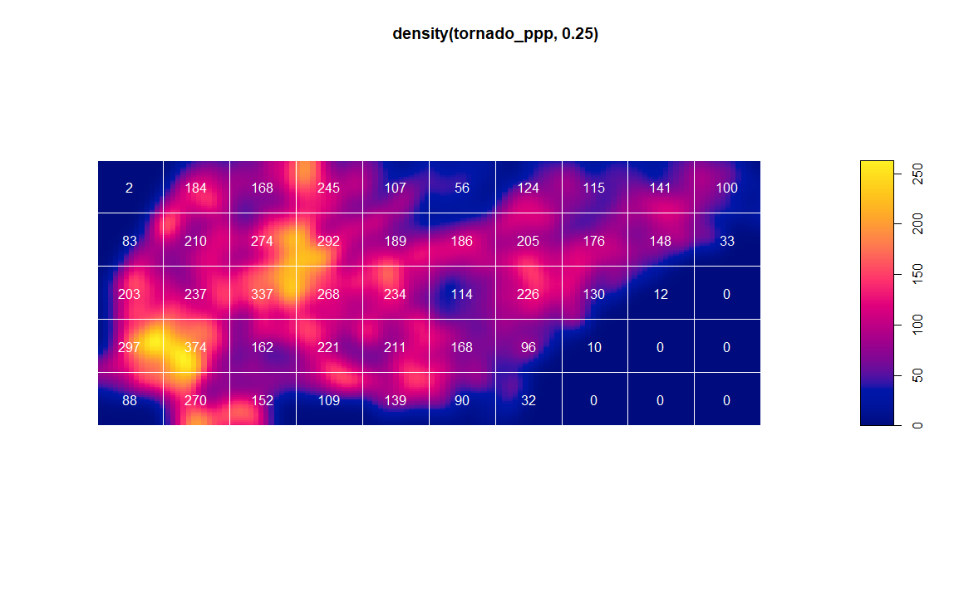
Kernel density & quadrats in R

